Slide 1
PROJECT PRESENTATION
PRIYANKA J.M - 7229 BATCH

Slide 2
STATISTICS AND DATA
Statistics deals with the Collection , Tabulation , Analysis and Interpretation of numerical data.
There are 2 types of statistics.
1. Descriptive Statistics
2. Inferential Statistics.
Data is a collection of facts such as information ,words and many things are observed and used for purpose of analysis.
It usually represent in text, images, numbers ,symbols...
Datas are first processing and then information is derived.

Slide 3
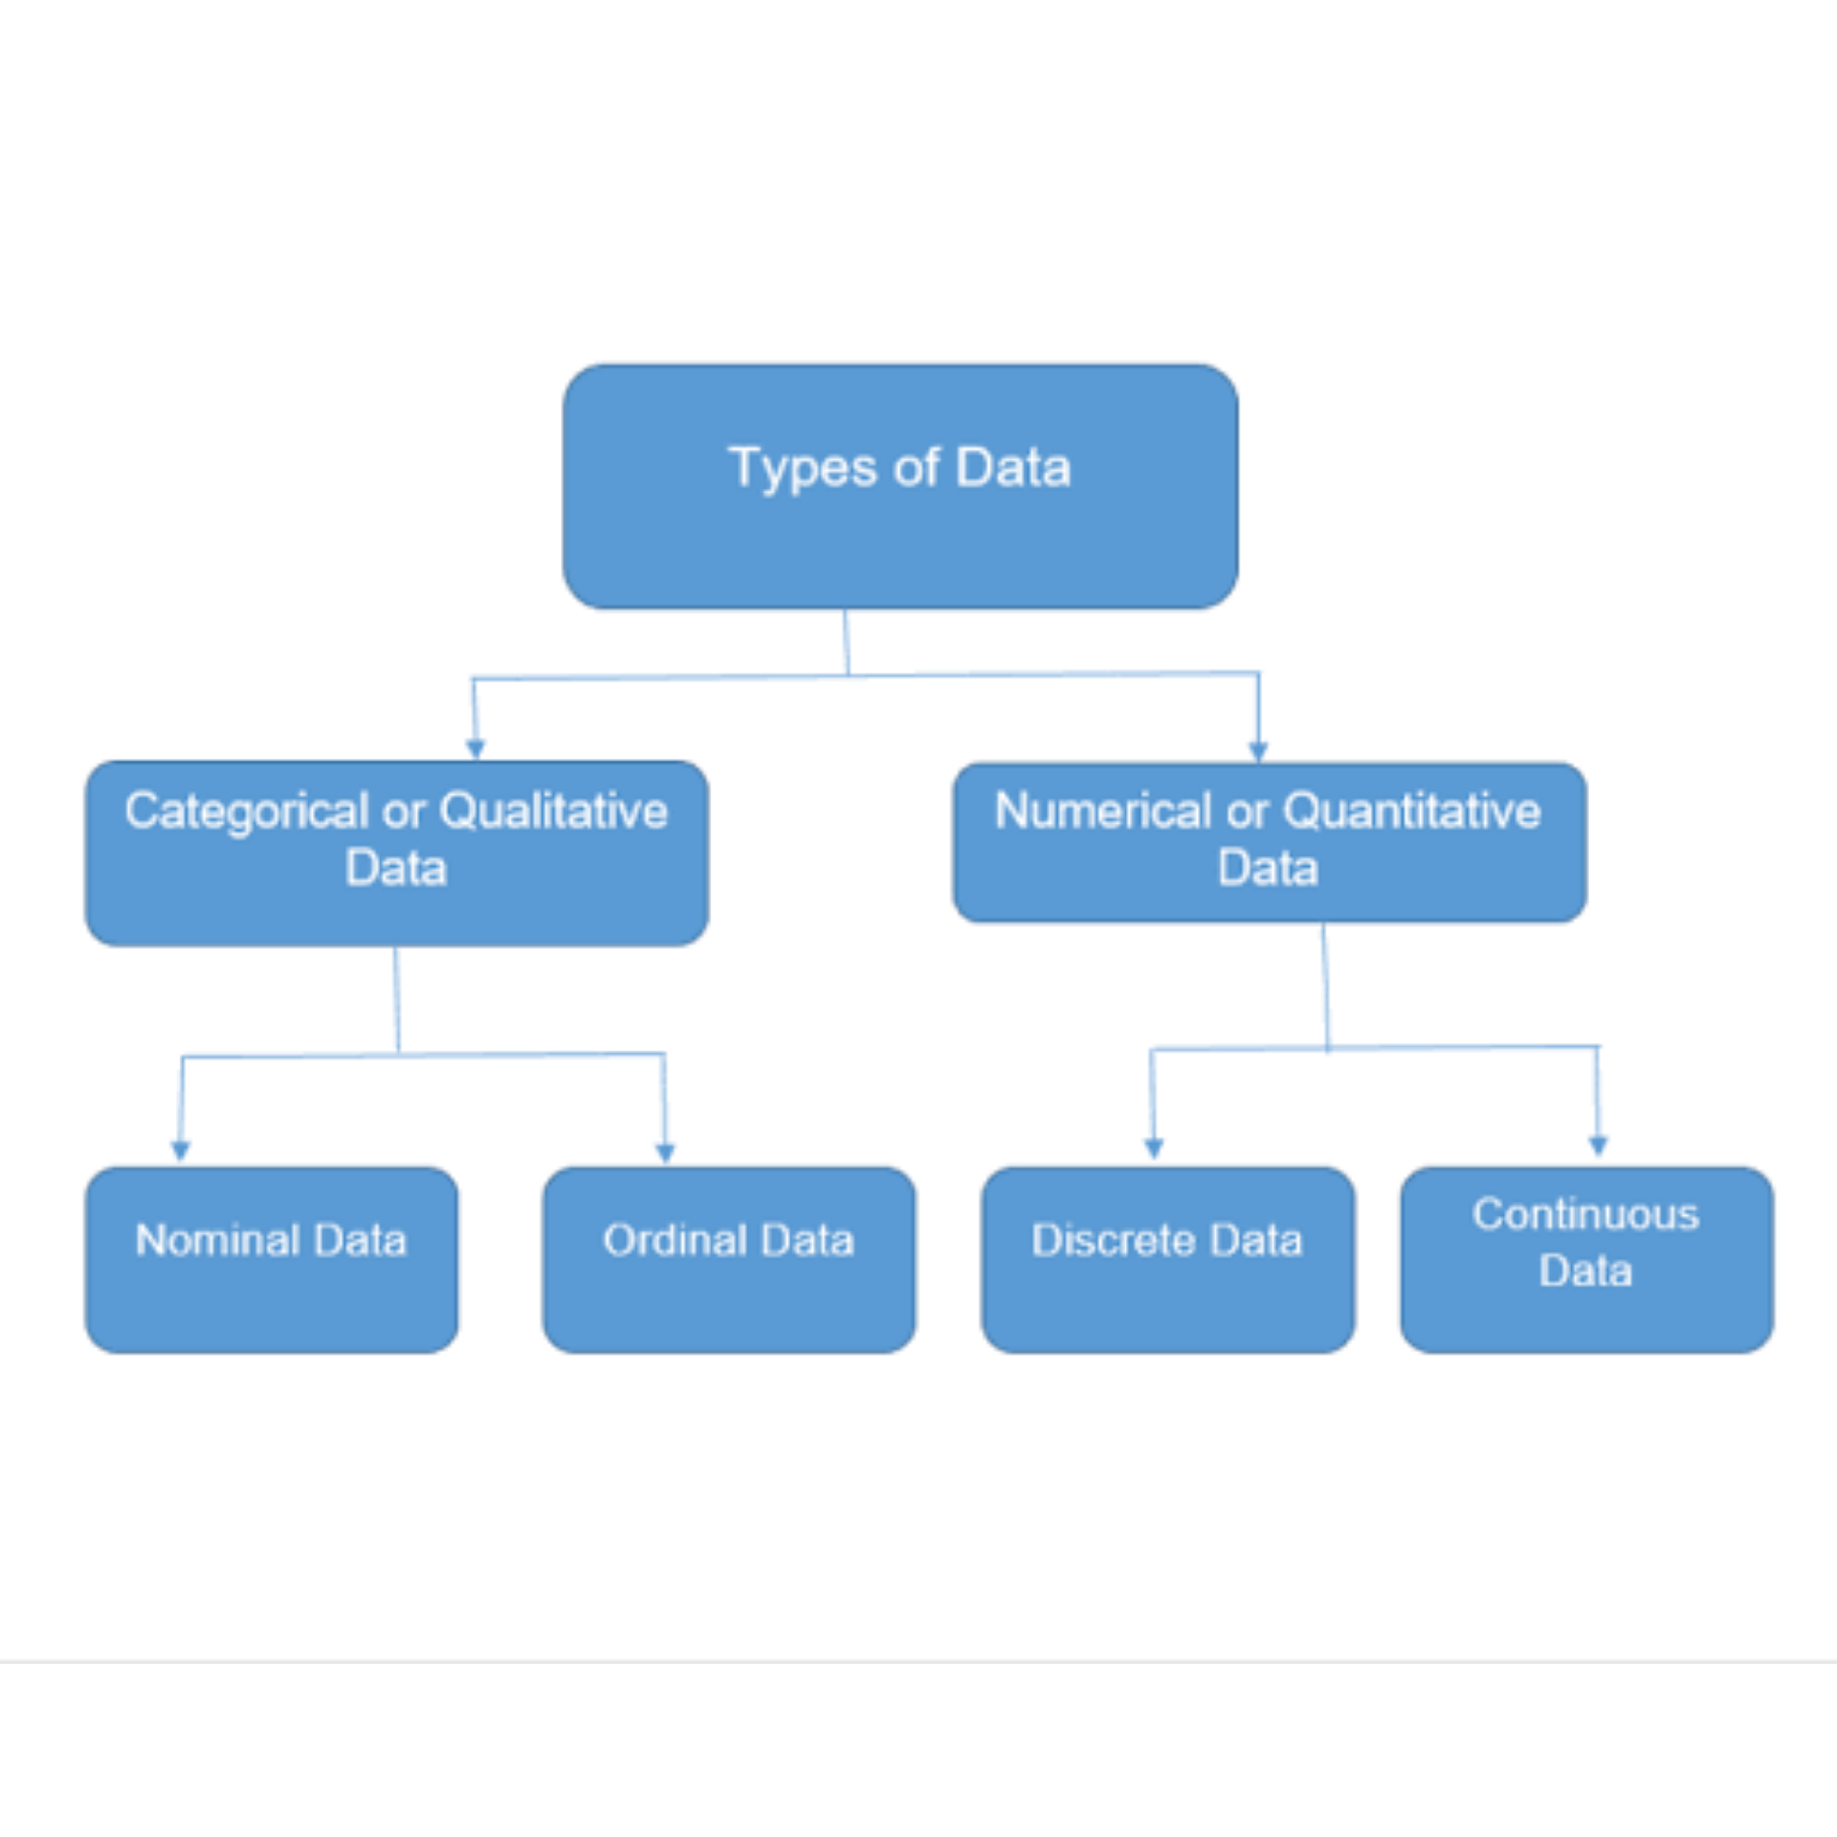
TYPES OF DATA
QUALITATIVE | QUANTITATIVE
1. Words. 2. Datas are not measured. | 1. Numbers. 2.Datas are measured.
3. Unstructured. 4.Colors,Beauty,taste. | 3.Structured. 4.Area,Height,ages.

Slide 4
SAMPLING
It is a technique of selecting process used in statistical analysis in which
a predetermined number of observations are taken from whole population.
TYPES OF SAMPLING
1. Probability sampling :
Random sampling ,Unbiased, Statistical.
2. Non probability sampling :
Non Random sampling ,Biased ,Analytical.

Slide 5
USES OF PROBABILITY SAMPLING
Reduce a sample bias
Diverse population
Create an accurate sample.
USES OF NON PROBABILITY SAMPLING
Cost effective.
Used for depth analysis.

Slide 6
DATA ANALYTICS
Analytics is the discovery ,interpretation and communication of meaningful patterns in data.
It refers to qualitative and quantitative techniques and process used to enhance productivity and business gain.
It is extracted and categorized to identify and analyze behavioral data and patterns and techniques vary according to organizational requirements.

Slide 7
THANK YOU

